Slide 1
IL
Inoki Labs
Crash-testing robot control policies before they ship
Notes:
Inoki Labs: crash-testing for robot control policies, in simulation, before they reach hardware.

Slide 2

Introduction
Robots learn to walk in simulation, then ship to the real world
Today policies are hardened through domain randomization - sampling friction, mass, latency, pushes and sensor noise at random, and hoping the test worlds covered the ones that matter
friction
latency
pushes
sensor noise
Fragile
Easy to miss
~92%
40 ms
⟶
of random test worlds where a baseline Go1 walking policy falls (CPU smoke run, 150 steps)
⟶
of control latency is enough to topple the same policy - which passes every nominal check
Notes:
Sources: BreakPoint equal-budget CPU smoke run (uniform arm, 354.5/384 failures, 2026-09-28) and SMOKE rating of the bundled Go1 demo policy (latency-40ms cell 3/4 falls, nominal 0/64 falls). Smoke budgets, not GPU ratings.

Slide 3
Problem
There are no standard tools to find where a robot policy breaks before it ships to hardware.
Notes:
Teams test policies on nominal conditions and a handful of random randomized worlds. Failures show up later, on real hardware, where they are expensive and dangerous.

Slide 4
Solution
Automated crash-testing for robot policies as a CI gate
Finds Real Failures
Comparable
Simple & Trusted
Directed search, not sampling
Treats the randomization space as a search space and hunts for the friction, latency and push settings where a fixed policy breaks
Ratings on a fixed battery
Every condition reports falls, fall rate and a 95% interval, so two policies rated on the same battery are directly comparable
Drops into CI, signed results
A GitHub Action fails the build when a candidate falls where production survived; ed25519-signed reports prove nothing was edited
Notes:
Open-source engine finds and tests failures. Commercial edition (Inoki Labs) fixes and certifies: hardening, Inoki-signed certification, hosted CI dashboard, enterprise support.

Slide 5
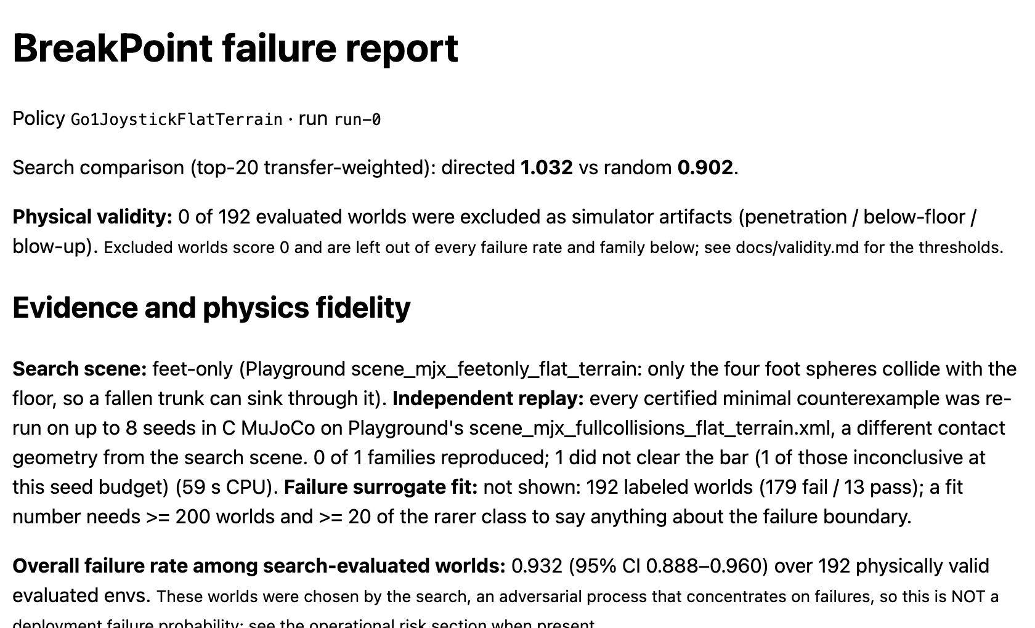
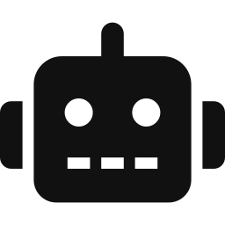



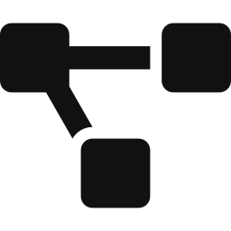

Solution Prototype Deep-dive
We have already built the engine and tested it on five robots
1.
Any trained policy - ONNX, brax, RSL-RL, Isaac Lab
2.
Policy check - confirms it walks before testing
3.
Thousands of worlds simulated at once in MuJoCo MJX
4.
Directed failure search on GPU
5.
Failures grouped into families, replayed in a second engine
Sample failure report
6.
Report, rating and CI verdict ready to share
Realistic failures found vs random sampling (sim)
2x
Notes:
Directed search found 304 failures inside plausible deployment ranges vs 156 for uniform random sampling (mean per seed, 384 rollouts per arm, 2 seeds, CPU smoke, bundled Go1 policy). Nearest failure to nominal: 0.82 vs 1.07. Caveat: the directed objective is weighted toward plausible conditions. Second-engine replay rates were too small to separate the methods; an earlier 6/8 vs 1/8 replay result did not reproduce.

Slide 6

Team
Two co-founders, backed early by Antler
Vihan Aggarwal | CEO & CGO
Subhi Stephan | CTO & CMO
MIT CSAIL · Mantis AI fellow
Duke BME and ECE
Purdue TRACE Lab: gas-leak detection on a quadruped
IEEE Best Paper, AIIoT 2026
Yale GRAB Lab, Nazarbayev ARM Lab
Author of kinfast (robot kinematics)
Research intern at MIT
Drug discovery research, Mount Sinai
Top 10, Blue Ocean Competition
Notes:
Founder photos still to add (grey squares are placeholders).

Slide 7
Vision
Inoki's crash-testing will become the safety standard every robot policy ships through.
Inoki Expansion
Use-cases
Users
Fleet-wide certification
continuous ratings of deployed fleets for insurers and regulators
Insurers · Regulators · Standards bodies
Inoki-signed certification
independent, verifiable ratings for procurement and sign-off
Logistics operators · Enterprise buyers
Hardening & robust retraining
fix the failures we find, retrain against them
Humanoid OEMs - Figure, Agility, 1X
Hosted CI dashboard
every checkpoint gated against production
Quadruped makers - Unitree, ANYbotics
Comparable ratings
battery scores with 95% intervals
Robot-learning startups and research labs
Open-source engine
find and test failures, free, no caps
MuJoCo / Isaac Lab users · open-source RL
Initial Focus

Slide 8
Expanding Total Available Market
$15B
$21B
$1.8B
Robotics simulation software market (2025) - the budget line we sell into
Humanoid robot market by 2030 - every policy needs testing before it ships
Robotics AI software market (2025) - total spend on robot intelligence
Sources: Marketintelo, Robot Simulation Software Market (2025); MarketsandMarkets, Humanoid Robot Market (2025-2030) and Robotics AI Software Market (2025).

Slide 9
Market Size Deep-dive - Legged & Humanoid Robots
10K+
Teams building autonomous robots
Total Available Market
2K
Teams training RL policies
Serviceable Available Market
10K gate runs / month
$60M / year
500
Legged & humanoid teams
Serviceable Obtainable Market
Usage
On average: ~20 candidate checkpoints per team per month, each gated on a 15-condition battery
Revenue
Assuming ~$120k per team per year - hosted CI, hardening and signed certification on top of the free engine
50
Teams on MuJoCo / Isaac Lab today
Immediate Market
Team counts and pricing are internal estimates.
Notes:
500 teams x 20 checkpoints = 10K gate runs/month. 500 teams x $120k = $60M/yr. All team counts and pricing are estimates to validate.

Slide 10
Our Start - Legged Robots
Go1 policy at nominal conditions
Same policy with 40 ms of latency
0%
75%
⟶
0 of 64 nominal rollouts fall - it passes every standard check
⟶
3 of 4 rollouts fall. One latency spike takes the robot down!
Key insights
Teams ship policies that pass nominal tests but break in conditions they never sampled
Directed search finds closer, more plausible failures than random evaluation at equal budget
Every rating and gate run builds a failure dataset that compounds into long-term defensibility
Notes:
SMOKE numbers: bundled Go1 demo policy, CPU, 150-step horizon. Nominal 0/64 from the equal-budget nominal check; 40 ms latency 3/4 from the smoke rating (lag-dropout 4/4 also failed). Not a full rating.

Slide 11
Competition
Finds real failures
Field tests · TÜV SÜD · UL Solutions
IL
Physical testing & safety audits - real, but slow and late
Directed failure search, CI-native, signed results
Isaac Sim · Gazebo
Simulators with hand-scripted test scenarios
Foretellix
CI-native & fast
(scenario testing for cars, not robot policies)
Random DR eval · Benchmark suites
Random sampling - fast, but misses the failures that matter

Slide 12
Competitive Advantage - Research
New way to test robot policies - search for failures instead of sampling them
Trained policy
Instead of random domain randomization we treat the parameter space as a search space and optimize for falls - one generation is one batched rollout.
Batched MJX search
Evidence layers on every failure:
Failure families
Plausibility ranking
Cross-engine replay
physical validity gate - simulator artifacts never count as failures
cross-engine replay - each failure re-run in C MuJoCo with a different contact model
Minimal causes
Ratings & 95% CIs
Signed attestation
Open core, paid fix - the free engine builds the funnel; hardening and Inoki-signed certification are the business
CI verdict & hardening

